Slide 1














Vanessa Battista, RN, MS, CPNP-PC, CHPPN
Pediatric Nurse Practitioner
Dominique Flores, RN
Pediatrics
Olivia Lemberger MSN, RN, CHSE
Clinical Nurse Educator
Lindsey Lachner, MSN, RN, Team Lead
Robin Torpey
DNP, BS, RN-BC
Sr. Analyst
Bohumil Borusek, MSc, MBA
Business Unit Manager,
Johnson & Johnson
Kristin Paulson, BSN, RN, Emergency Room Nurse, CNS Graduate Nursing Student, Michigan State University
Emmalyn Ramos, UX Designer
Chinmay, Kelkar, Software Engineer
May 16, 2020
#NURSEHACK4HEALTH
Gloria E. Barrera, MSN, RN, PEL-CSN
Public Health Nurse
Sigal Shafran
Michelle Munro-Kramer, PhD, CNM, FNP-BC
Assistant Professor
University of Michigan, School of Nursing
Kim LeBiavant, RN, MSN, ANP, Product Dev
Notes:
Emma

Slide 2


Challenge
18-34 year old's can change the world by making informed decisions
#ChatBotSavesLives
Notes:
In some settings there are clusters of people together that do not realize there is a pandemic
20-34 year olds are 20.5% of population and approximately 67 million people in US

Slide 3

Educate, Empower & Share On
Less precautions = more cases
Understand guidelines
Efforts to stop the spread
Notes:
Percentage of US Adults who use a Health App
Women: 25% in the 18-34 age range
Men: 25% in the 18-49 age range
Report from Europe (Brix) showed:
-Reports coming out of France and Italy about some young people getting seriously ill and being admitted ICUs
-With less precautions, may see more cases in this population
-Millennials need to heed recommendations to physically distance themselves
Health authorities argue that "younger people who think they won't be affected are hurting efforts to stop the spread and are putting others at risk
https://www.statnews.com/2020/03/18/u-s-official-says-data-show-severe-coronavirus-infections-among-millennials-not-just-older-americans/
COVID19 Disruption
*Lack of real-time information targeted for "Millennials" (18-34 year old's)
I THINK THIS IS COVERED LATER:
Accurate, relevant, & up-to-date information
Location mapping
Social media integration

Slide 4
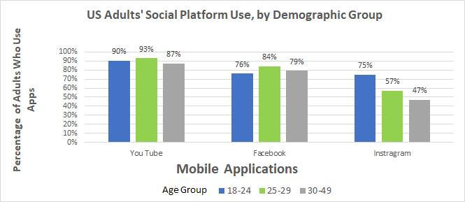
Target Population Data
01
70% use social networking apps
02
74% open an app when bored
3x more excited about new
apps/features
03
Adapted from: https://mindsea.com/app-stats/
Notes:
Robin and Vanessa
Nearly 70 percent of millennials say social networking apps are among their most commonly used. (MindSea)
76 percent of millennials say their phone is useless without mobile apps & 74 percent open an app when bored. (ComScore)
Millennials are more willing to pay for mobile apps, with 1/3 purchasing more than one per month. (ComScore)
Younger smartphone users spend the most time on mobile apps. (ComScore)
Millennials are three times more likely to be excited about new mobile apps and features than older users.
Logo/color matters: · (In 2017, 21 percent of millennials said they deleted a mobile app because they didn’t like the app logo. (ComScore) )

Slide 5
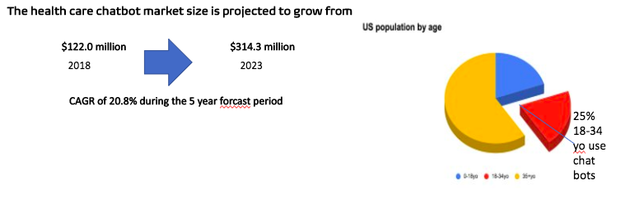
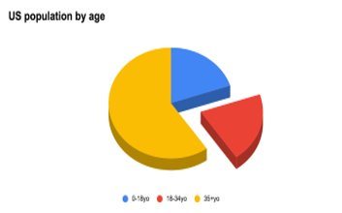
B2B - Market Size Chat Bot Subscriptions​
01
02
$2.6 billion 9.4 billion by 2024
2019
29.7% CAGR
Notes:
Kim -
Talking points-
-Chatbots can be applied to virtually any vertical or business and the Covid 19 pandemic has driven an urgent need to streamline medical triage taking the load of nurses and other medical workers and getting up to date information out.
-The healthcare chatbots market is expected to reach $314.3 million by 2023 from USD 122.0 million by 2018, at a CAGR of 20.8% for those 5 years. The rising Internet connectivity and adoption of smart devices and the need for virtual assistance are factors driving the market.
In the health chat bot market, bots for medical triage is expected to hold the largest share of the market however, in terms of growth rate, patient engagement is likely to grow at the highest CAGR of 26.52% during the forecast period.
However, concerns regarding data privacy, lack of expertise for chatbot development, and lack of awareness pose a significant challenge to the market growth. "
Source:
Bullet 1: https://www.researchandmarkets.com/reports/4843081/global-chatbots-in-healthcare-market-focus-on#pos-0
https://www.researchandmarkets.com/reports/4450213/global-chatbots-market-outlook-to-2022#rela4-4581847
Bullet 2 (Michelle) :
20-34 year olds are 20.5% of population and approximately 67 million people (2020 Census Data)
Business Insider experts predict that by 2020, 80% of enterprises will use chatbots.
Sources:
https://chatbotsmagazine.com/chatbot-report-2019-global-trends-and-analysis-a487afec05b
https://www.businessinsider.com/80-of-businesses-want-chatbots-by-2020-2016-12?op=1

Slide 6
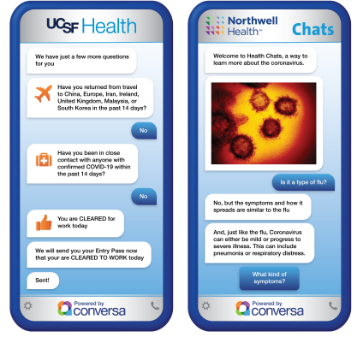
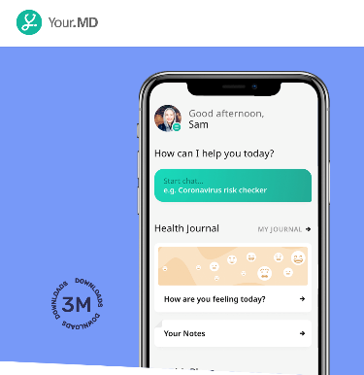



Competition
Notes:
Script Aspect (Nikkei):
All chatbots out there operate in the sense that it includes functionality to support information sharing, symptom tracking, and workforce management related to call-center burnout. However, current chatbots out in the market require the end-user to SEEK out information about that hospital facility – whether public or private. Even the CDC requires the end-user to explore the website before finding the symptom self-checker chatbot.
Realistically speaking and taking into consideration of the “invincibility psychology” of this population (It doesn’t hit you until it affects someone you know.), they won't want to readily seek out this information from websites regardless of the credibility. To tackle this aspect, the plan is for our chatbot to be integrated into social media apps highly used by this target population which will empower adults to
Apps and health journals are great but target the population who are highly proactive in taking care of their health. But what about those who aren't as proactive or knowledgeable but still want a way to retrieve information about resources in their local area?
Sources
Addresses healthcare provider burnout on triage & information dissemination
https://www.fiercehealthcare.com/tech/alphabet-s-verily-rolls-out-covid-screening-tool-for-health-systems
Verily is focused on developing other healthcare tools, including expanding features and functionality to support more information sharing, symptom tracking, and workforce management, Lee and Washington wrote.
The screening tool can take the form of a chat or voice bot and provides patients answers to their questions about symptoms or health risk factors. The chatbot also provides relevant information tailored to their responses, Verily said.
Verily's COVID-19 Pathfinder tool (Verily)
There is currently an overwhelming demand for actionable, up-to-date information. that is creating a significant strain on resources as nurses and staff are managing a high volume of questions and concerns from patients.
https://www.healthcareitnews.com/news/northwell-ucsf-unc-using-chatbot-and-related-tech-manage-covid-19-patients
MARKETPLACE
Vendors that offer chatbot technology and services include Care Sherpa, Conversa Health, Element Blue, Kore.ai, Lifelink, LivePerson, Orbita, Phase2, Podium, Sensely and SymphonyRM.
"Some of the major key players in the global chatbots in healthcare market include Babylon Health, HealthJoy, Pact Care BV, Health Tap, Gyant.com, Inc, Infermedica, Sensely, Your.MD, Lifelink Inc, Buoy Health, Inc, X2.ai, Wysa, Ltd, Woebot Labs, Inc, and Kik Interactive, Inc. "
MEETING THE CHALLENGE
Montefiore Health System added the COVID-19 assistant to its website HTML code using a JavaScript snippet that was provided by Hyro.
“Our web team was readily able to deploy the technology,” Mammen said. “In one week’s time, we already had hundreds of unique daily users interacting with the conversational interface through both voice and text.”

Slide 7
Competitive Analysis
Chatbot | Design | Usability | Diagnostic process | Credibility Accuracy | Price | Extras
INTELEFORM | +++++ | +++++ | +++++ | +++++ | free | +++++
Mayo Clinic | +---- | +++++ | ++++- | ++--- | free | +----
WEBMD | +++-- | ++++- | ++++- | ++--- | free | +++--
SYMPTOMATE | ++++- | ++++- | ++++- | ++--- | free | +++--
ADA | +++++ | +++++ | +++-- | +++-- | free | +++--
YOUR.MD | ++++- | +++++ | ++++- | ++++- | free | ++++-
Source: Medicalfuturist, https://cdn.medicalfuturist.com/wp-content/uploads/2019/04/The-Big-Symptom-Checker-Review_upd.png

Slide 8
Why Are We Unique?
Only health bot targeted to 18-34 year old's
Service Bot
Increases user engagement on platform/site
Versatile
Anywhere: academic settings, military, HR in large companies
Top Apps: YouTube, Facebook, Instagram
Dating Apps: Bumble, Tinder
Notes:
Script Aspect (Nikkei):
All chatbots out there operate in the sense that it includes functionality to support information sharing, symptom tracking, and workforce management related to call-center burnout. However, it requires the end-user to SEEK out information about that hospital facility – whether public or private. Even the CDC requires the end-user to explore the website before finding the symptom self-checker chatbot.
Realistically speaking and taking into consideration of the “invincibility psychology” of this population (It doesn’t hit you until it affects someone you know.), they won't want to readily seek out this information from websites regardless of the credibility. To tackle this aspect, the plan is for our chatbot to be integrated into social media apps highly used by this target population which will empower young adults
Sources
Addresses healthcare provider burnout on triage & information dissemination
https://www.fiercehealthcare.com/tech/alphabet-s-verily-rolls-out-covid-screening-tool-for-health-systems
Verily is focused on developing other healthcare tools, including expanding features and functionality to support more information sharing, symptom tracking, and workforce management, Lee and Washington wrote.
The screening tool can take the form of a chat or voice bot and provides patients answers to their questions about symptoms or health risk factors. The chatbot also provides relevant information tailored to their responses, Verily said.
Verily's COVID-19 Pathfinder tool (Verily)
There is currently an overwhelming demand for actionable, up-to-date information. that is creating a significant strain on resources as nurses and staff are managing a high volume of questions and concerns from patients.
https://www.healthcareitnews.com/news/northwell-ucsf-unc-using-chatbot-and-related-tech-manage-covid-19-patients
MARKETPLACE
Vendors that offer chatbot technology and services include Care Sherpa, Conversa Health, Element Blue, Kore.ai, Lifelink, LivePerson, Orbita, Phase2, Podium, Sensely and SymphonyRM.
MEETING THE CHALLENGE
Montefiore Health System added the COVID-19 assistant to its website HTML code using a JavaScript snippet that was provided by Hyro.
“Our web team was readily able to deploy the technology,” Mammen said. “In one week’s time, we already had hundreds of unique daily users interacting with the conversational interface through both voice and text.”
No chatbot geared for this target population
As social media changes, back-end should accommodate to this.
Actual Size
Minimal Viable Prodcuts – MVP
CDC – Manual Process; Ours – autopopulation
American Academy of Pediatrics --
Why are we different:
Social-media Integration – What's App, Facebook, etc.
Dating Apps: Bumble, Tinder,
Addresses healthcare provider burnout on triage & information dissemination

Slide 9
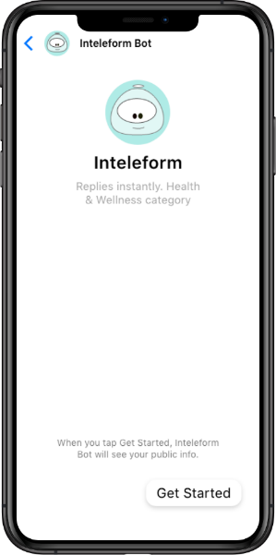
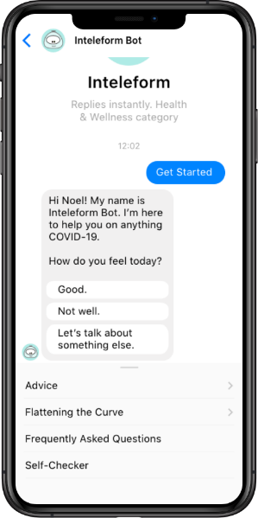
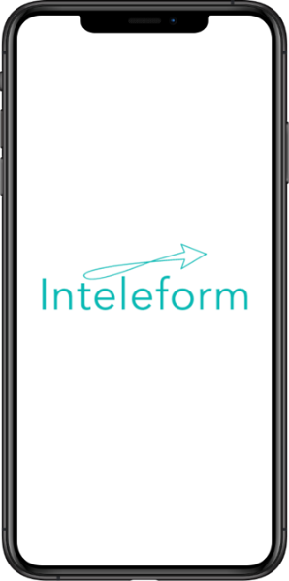
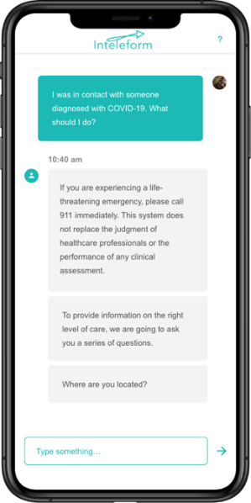

Inteleform User Interface Mockups
Notes:
Emma

Slide 10
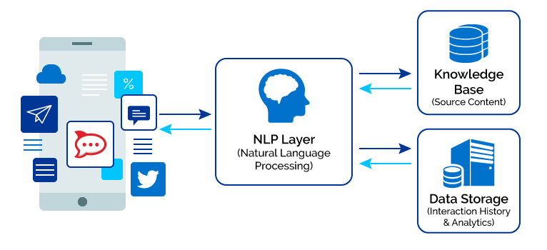
Inteleform Architecture
Azure Botservices
Channel creation to social media
Mobile App & Bot Integration
"Simple, factual, easy to navigate"
Notes:
Chinmay-

Slide 11
Impact and Innovation
01
02
03
Interactive tool to make healthy choices
Real time location-based information
Social media connectivity
Notes:
Gloria
Impact & Innovation Info from Gloria & Saijel Verma—
1. Empowering ineractive tool for health choices
2. Direct impact based real time location based information
What is our product? The Inteleform ChatBox is an innovative, interactive tool built to help young adults engage with the COVID-19 pandemic on a more personal level for them to receive direct health education, feel empowered on making health choices, and share on to others. Rationale: Most COVID-19 messaging is targeted at older adults, leaving a wide swath of our population relatively uninformed and disconnected from the issue. Until our entire population recognizes that this pandemic is theirs just as much as anyone else’s we cannot launch a united front against the virus, thereby continuing to put our population and livelihoods in jeopardy. What is its impact? Inteleform operates with a three-pronged approach – engagement, education, and sharing on. The tool’s messaging is uniquely catered toward attracting 18-34 year olds through specifically-catered emotional rhetoric and accessibility on commonly-used social media platforms (ie. Instagram, Facebook, Tik Tok). Content on the chat bot will center around how millennials can help stop the spread of COVID-19 and protect their own families/communities. The end goal is to be persuasive enough that the chat bot and the information that it disseminates is shared in a viral fashion throughout the 18-34 year old population. How is it innovative? A chat bot increases user engagement as it is significantly more interactive than a simple website design. The information disseminated is also more relevant given that it is tailored to the user’s age group and location.

Slide 12
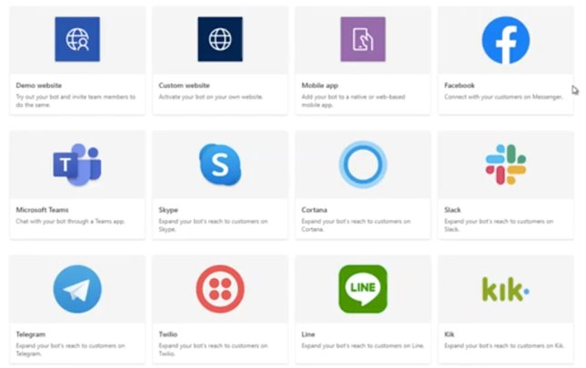
Go to Market Strategy
B2B Subscription Service
Scalability
Up-to-date health information
Brand recognition and user engagement
Notes:
Kim-
Talking Points –
1. As mentioned before, Chatbots can be applied to virtually any site, app, or business. Some examples are
a. academic settings that want students to get up to date information and access health services when needed
b. dating sites that want to offer a new feature to increase user ingagement and stand out from other dating apps as people start to socalize again.
c. and for human resource departments of companies who have a large anount of 18-34 yo working there and want ot help keep their employes safe.
https://chatbotsmagazine.com/chatbots-the-new-subscription-box-business-model-14a6ca8380e0
Customer Acquisition
We will target subscriptions at colleges/universities where approximately 92% of students are ages 18-34 year olds (Bill & Melinda Gates; https://postsecondary.gatesfoundation.org/what-were-learning/todays-college-students/) & employers where 18-34 year olds make up approximately 36% of the workforce (US Bureau of Labor Statistics, 2018; https://www.bls.gov/emp/graphics/2019/labor-force-share-by-age-group.htm)
Market Analysis
Customer Acquisition
What's already available on the market?
- Marketing directly to colleges
-What is the feeling of the app?
-Subscription service
-Target to colleges
-Target to HR who need to keep staff safe
-Target to military.
Scalability is ensured with this product as chatbots can be applied to ANY web site, app, or business that wants to prolong user engagement and reduce customer pain.
Inteleform health bot adds value to any site because it give up to date health information for covid OR ANY OTHER DISEASE.
Novel uses to interact with 18-34 yo through dating apps can establish Inteleform's brand and create recognition and increase user engagement on sites.

Slide 13
Team 3 Leadership and Contributors
Technical Leads
Strategists
Chinmay Kelkar, MS
chinmaypkelkar@gmail.com
Robin Torpey DNP, BS, RN-BC RTorpey@its.jnj.com
Gloria E. Barrera, MSN, RN, PEL-CSN - gloriabarrera.rn@gmail.com
Vanessa Battista, RN, DNP - vbattis2@jhu.edu
Kim Le Biavant, RN, MSN, ANP-BC - lebiavant@gmail.com
Bohumil Brousek, MBA - brousek.b@gmail.com
Dominique Flores, BSN, RN - nikkei.flores@comcast.net
Olivia Lemberger, MSN, RN - olivialemberger@gmail.com
Michelle Munro-Kramer, PhD, CNM, FNP-BC - mlmunro@umich.edu
Kristin Paulson, BSN, RN - heinri16@msu.edu
Saijel Verma (CS Student) - saijel.verma@yale.edu
Christina Tuttle (CS Student) - christina.tuttle@yale.edu
Design Lead
Emmalyn Ramos, UX Designer, emmalynlramos@gmail.com
Team Lead
Lindsey Lachner, MSN, RN lindsey.lachner@gmail.com

Slide 14
Q&A

